Slide 1

CSS – Media Query

Slide 2
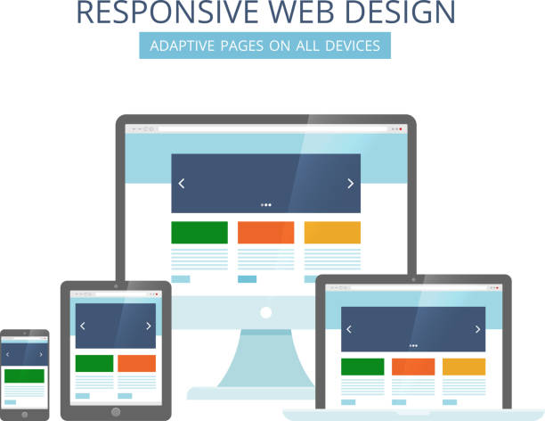
What is Responsive Design ?
Responsive design means Your web page should look good, and be easy to use, regardless of the device.

Slide 3
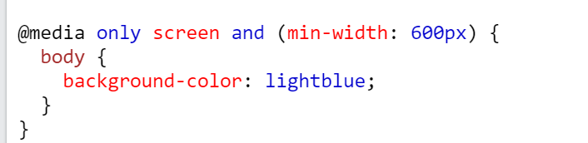
Media Query
rule to include a block of CSS properties only if a certain condition is true.

Slide 4
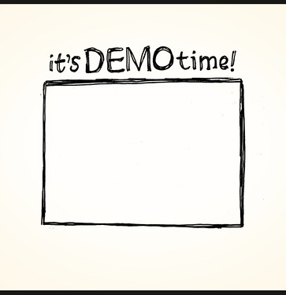
Media Query Demo
Let’s see demo on media query

Slide 5

Mobile first design
Start the product design from the mobile end which has more restrictions, then expand its features to create a tablet or desktop version.

Slide 6
Now we will do an example on media query with flex
But first let’s review flex

Slide 7
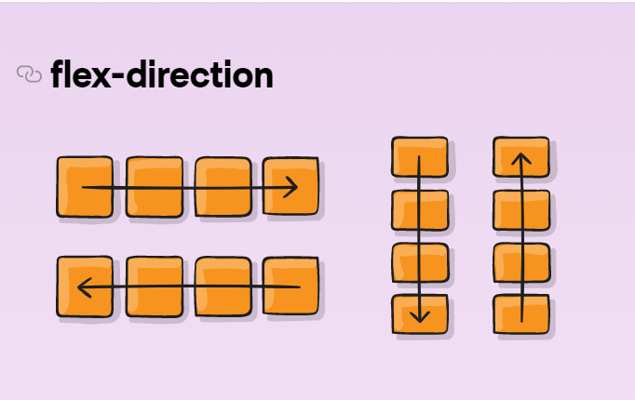
Flexbox
Display: flex;
- Let's see code samples to review it properties.

Slide 8
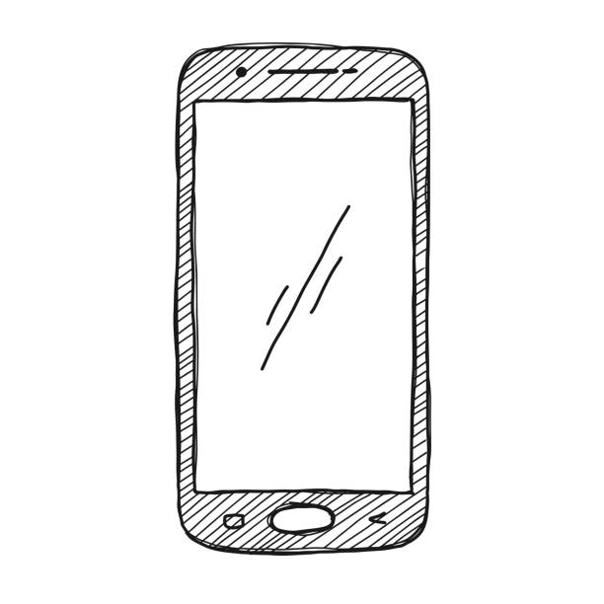
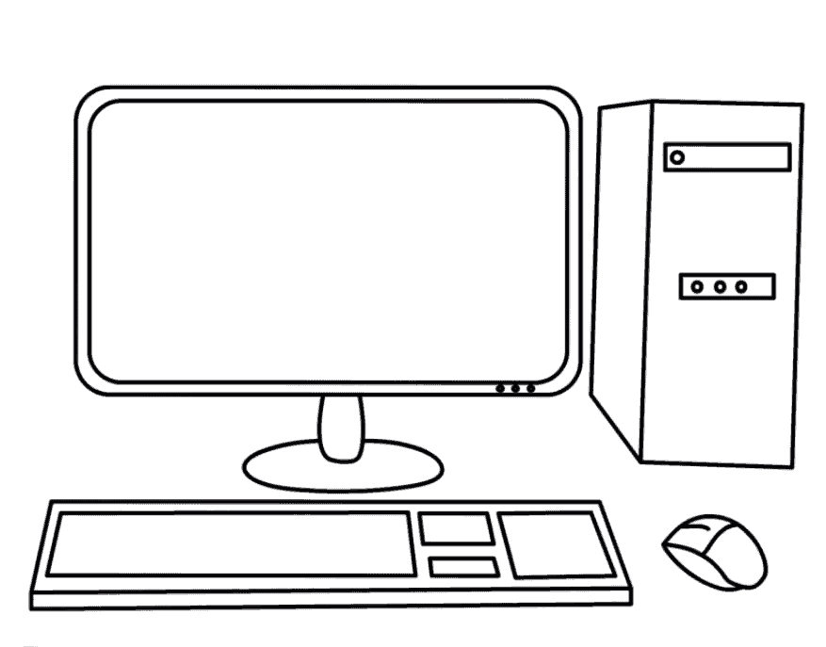
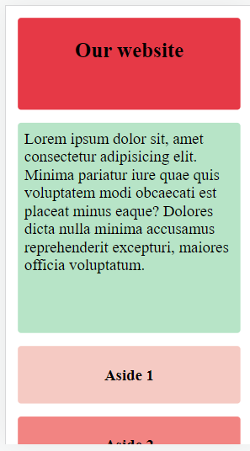
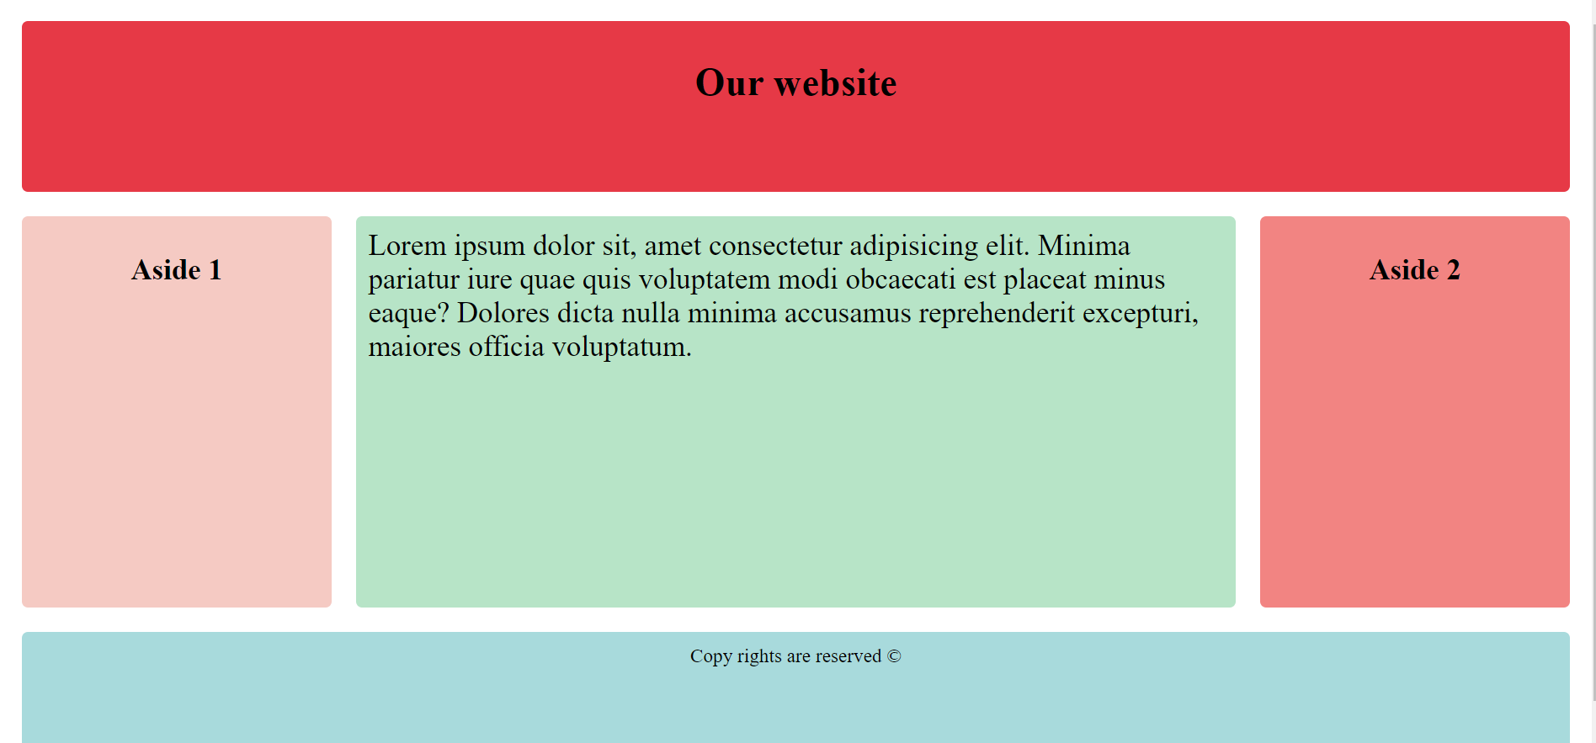
Flex and Media Query

Slide 9

Thank You

